Slide 1

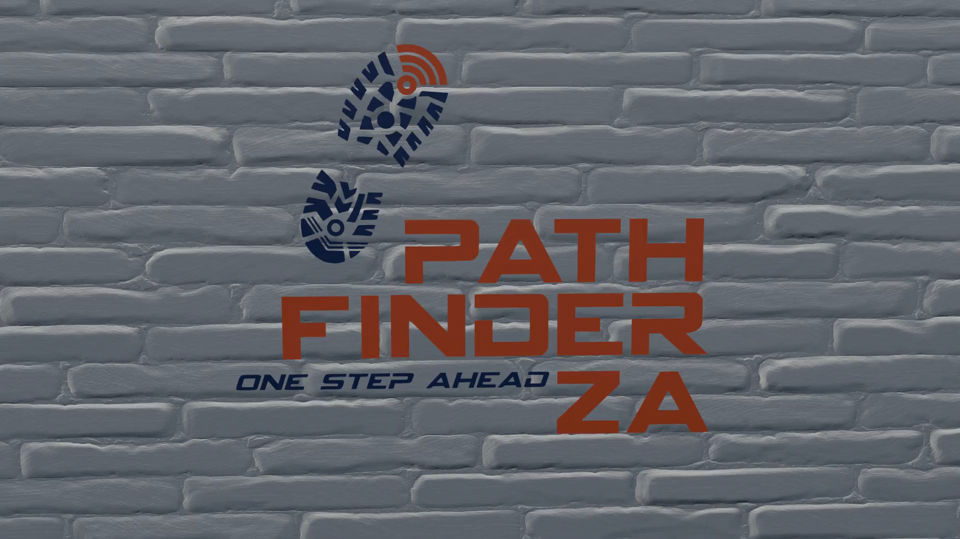
Find your threat, before it finds you

Slide 2
Who are we?
PathfinderZA is a complete security provider service.
The security solution was developed in collaboration with Keystone Electronic Solutions.
  Unattended ground sensor (UGS) will detect and report threats.
  Detected threat alarms are collected over various networks via TULIP.
  TULIP notifies users and guard rooms of detected threat.
PathfinderZA deploys armed response to threat location.

Slide 3


How it all began…
PathfinderZA recognised a need for stealth detection and monitoring of threats to enable them to capture threats before they can cause damage or inflict harm.
Developed by

Slide 4
How it all began…
Keystone Electronic Solutions is a research and development company specialising in design and manufacturing electronic turnkey solutions.

Slide 5

How it all began…
Telemetry, Unified Logistics, and Integration Platform
TULIP provides the platform where threat detection events are captured and recorded. TULIP then notifies users through sending an alarm indicating where the threat has been detected on a map.
Developed by

Slide 6
Key
Features
Camera integration
Unattended ground sensors
Multiple network support
Customised threat notification
Security personnel tracking
Armed response to detected threats
Developed by

Slide 7
PTZ Camera Integration
Position Tilt and Zoom (PTZ) cameras are integrated through the use of TULIP.
As UGS sensors are triggered in a zone cameras will point to the pre-set PTZ’s.
PTZ’s are customisable to individual requirements.
Developed by

Slide 8
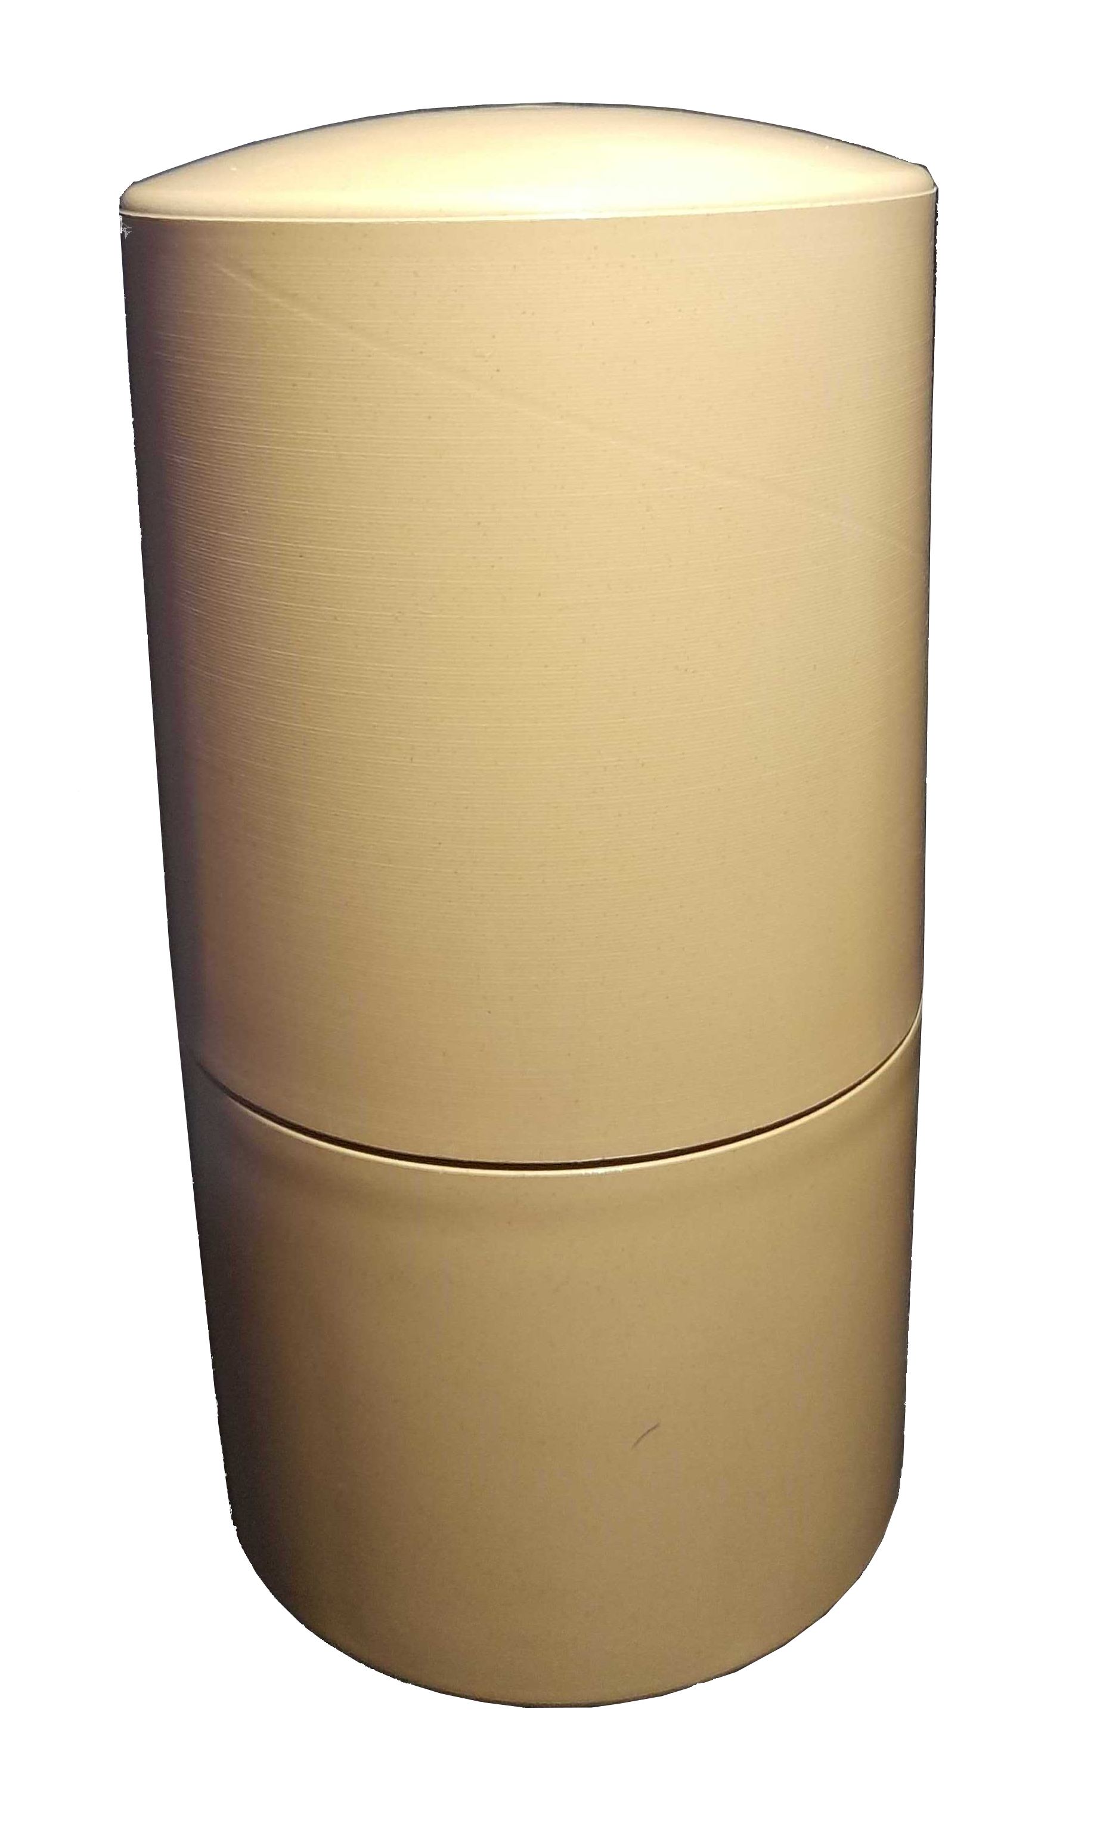
Unattended Ground Sensor (UGS)
Detects and reports threats.
Can differentiate between foot traffic and vehicle movement.
Supports LoRa and Sigfox networks. Easily adaptable to other networks.
Lifespan of two years.
Detailed activity monitoring lets users easily keep track of threat movements without giving any indication that their activities have been detected.
Developed by

Slide 9

Supports various networks
UGS alarms are collected over existing Sigfox or LoRa networks.
Proprietary LoRa network can be deployed in remote locations.
Extensible to support more networks
i.e., NB-IoT.
Developed by

Slide 10

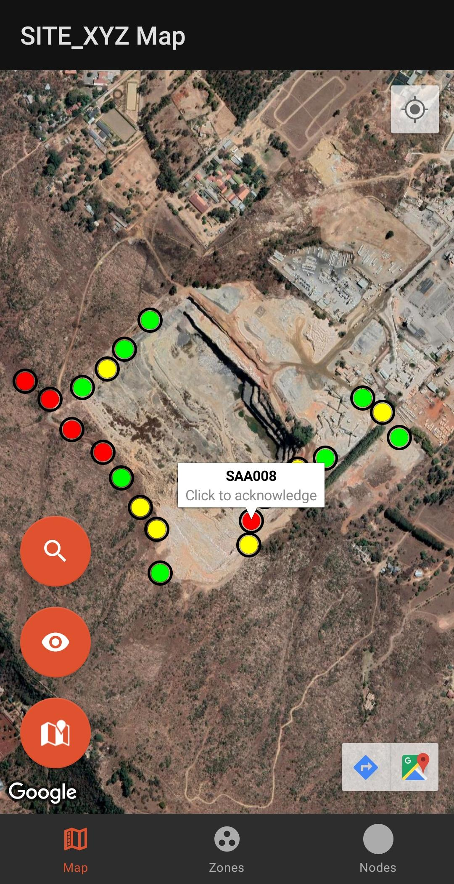
Notify users of threats
Users are notified of alarms at sensors on their mobile phones.
Allocated users will have access to see alarms with its distinguishable icon on a map along with the unattended ground sensors locations.
Developed by

Slide 11
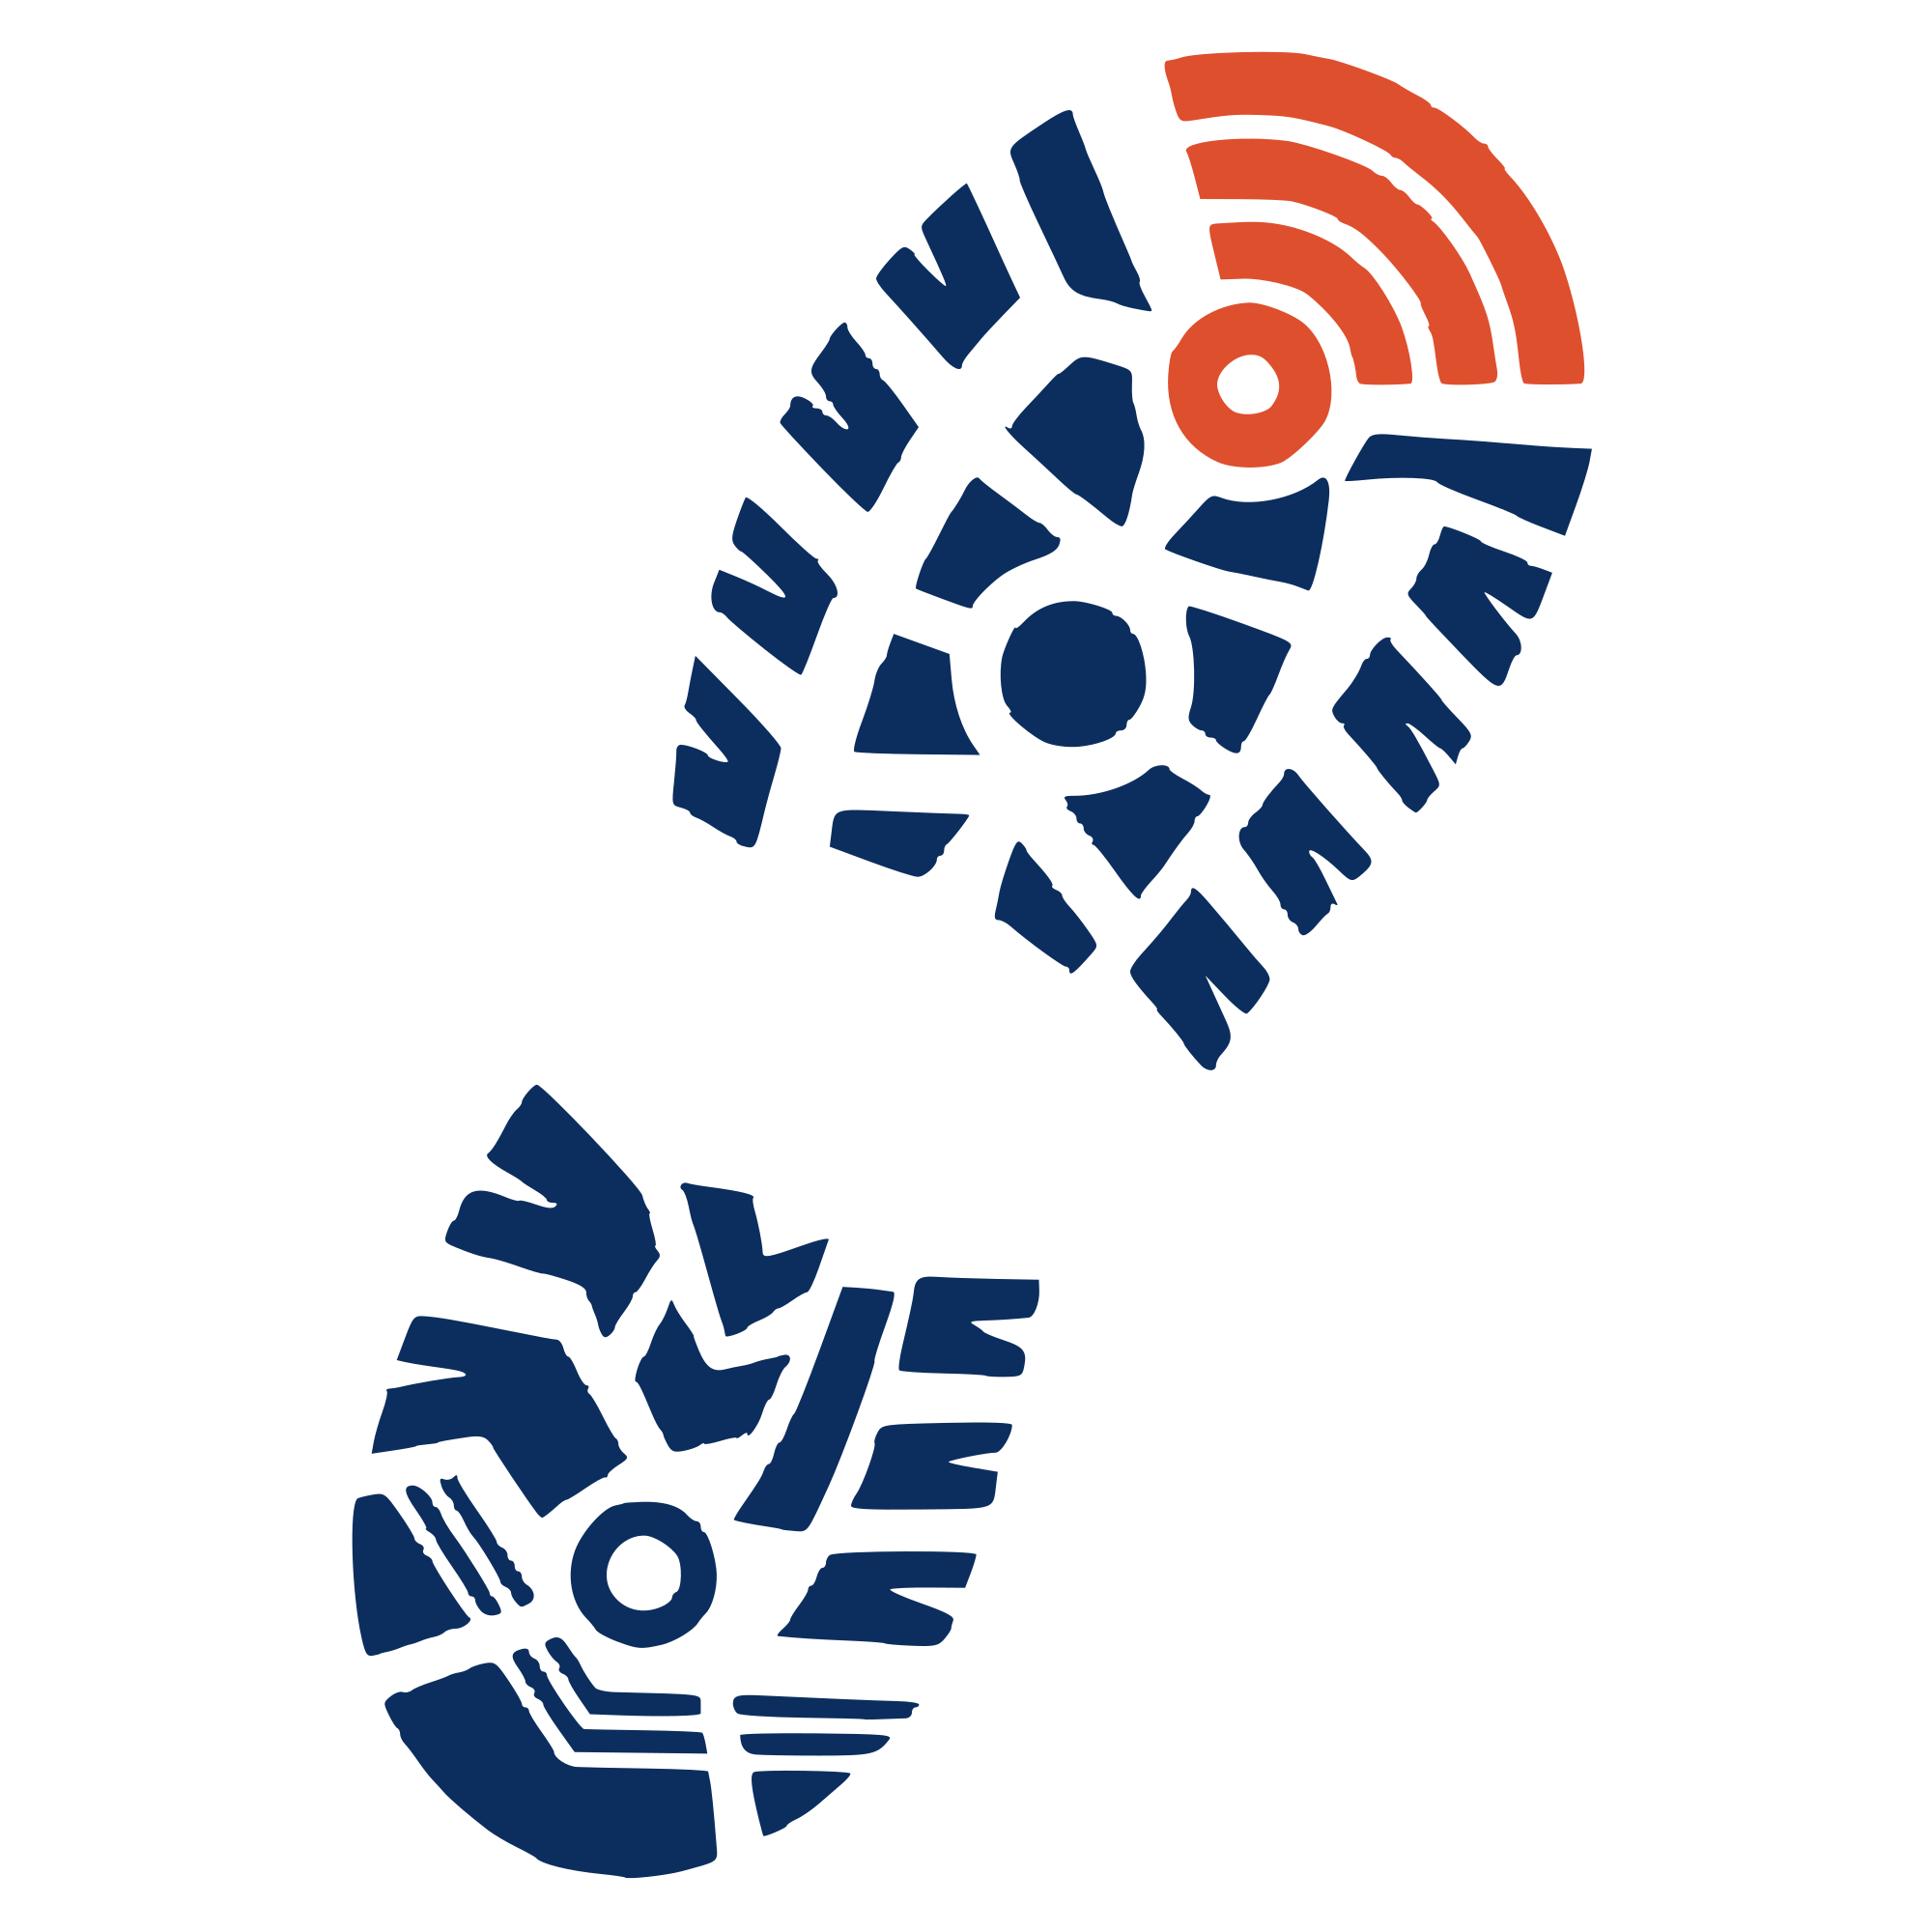
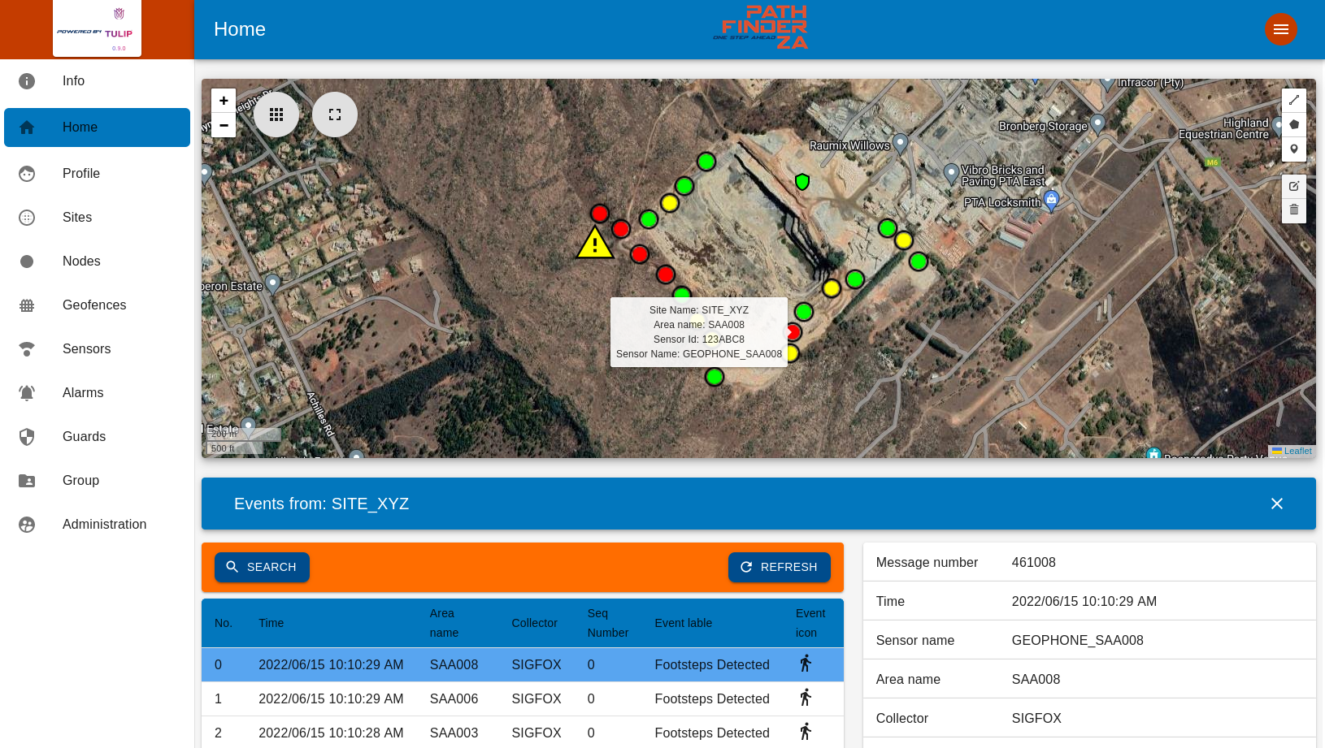
Notify
Guard rooms of threats
The PathfinderZA web-based monitoring platform provides a view of alarm and tracking information.
Users with specific privileges are able to see:
  Last location of guards
  Guard patrol routes
  Current location of sensors
  Sensor alarm states.

Slide 12

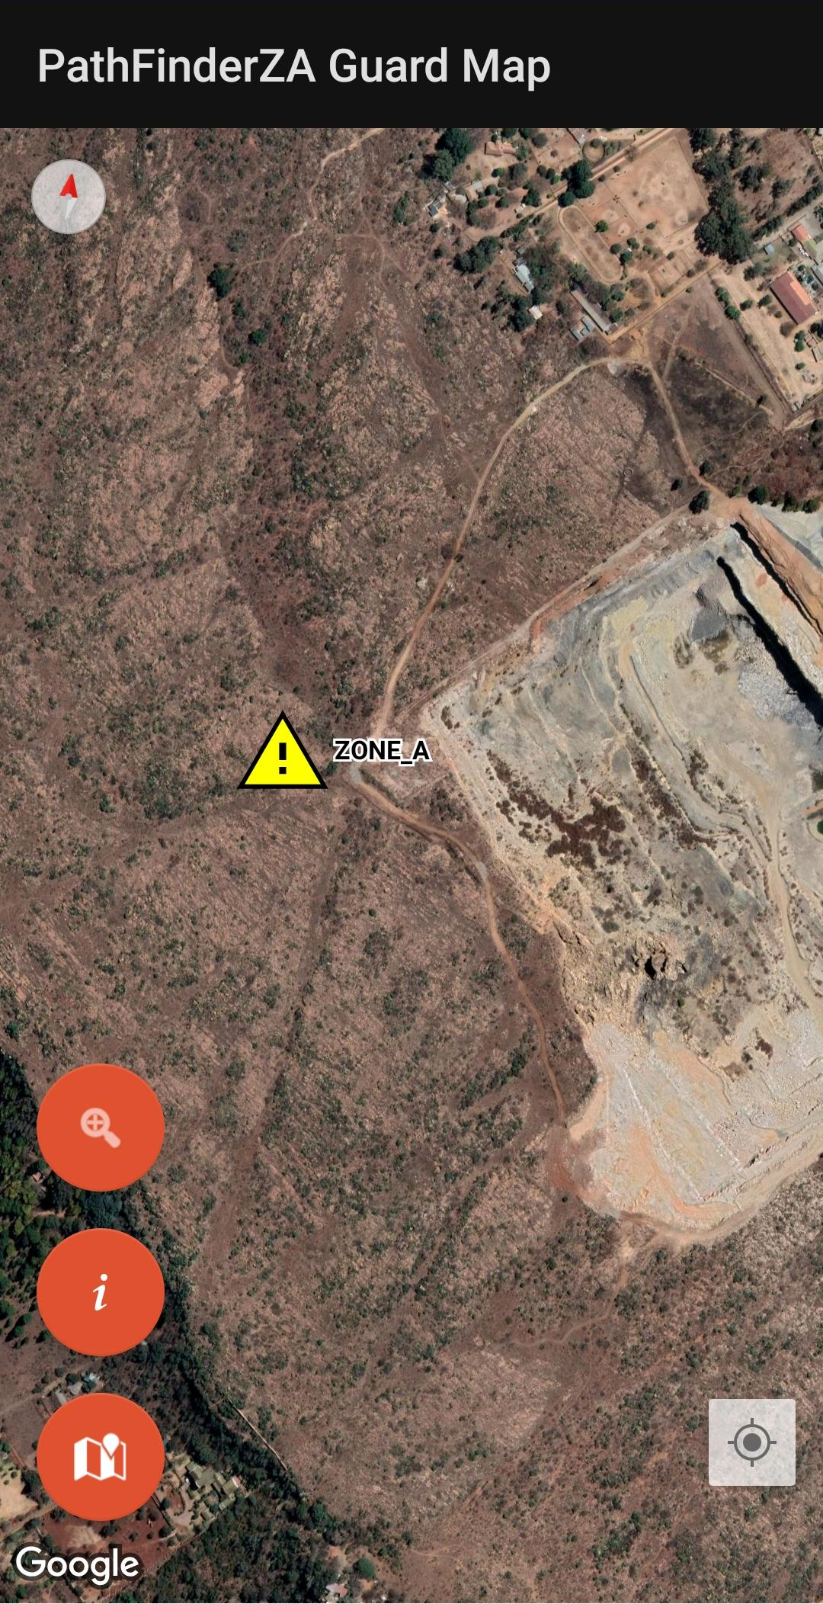
Track
Guards
PathfinderZA guard application is capable of tracking guard patrol and attendance.
Keep record of guards' movements and response times.
Application acts as a tracking device and sends guard coordinates at a set report rate to the web-based platform.
The web-based platform indicates the guard's name and time when responding to an alarm.
Developed by

Slide 13
Armed response to threats
PathfinderZA provides 24 hour armed response to threats, before they become a threat to valuable assets.

Slide 14
Further
System Benefits
Locally developed, manufactured and supported
Unified interface for all networks
Asset tracking and record keeping allows for analysis of events after the fact.
Developed by

Slide 15
Contact us:
Number: +27 (0)86 040 1017
Email: willem@pathfinderza.com
Website: www.pathfinderza.com
Number: +27(0)12 460 4135
Email: ivan@kses.net or info@kses.net
Website: www.kses.net

